Slide 1
Mass Spectrometry Lec.7

Slide 2
Alkenes Acyclic Alkenes • Relatively strong M⁺ ion • A series of peaks: M-15, M-29,M-43,M-57, etc • Strong peak from fragmentation to form a resonance stabilized allylic cation(m/z = 41 in terminal double bond. * homolytic cleavage to give allylic carbocation

Slide 3
- An important fragment in the mass spectra of terminal alkene, the Allyl carbocation ,occurs at an m/e of 42. it is due to cleavage of the type:

Slide 4
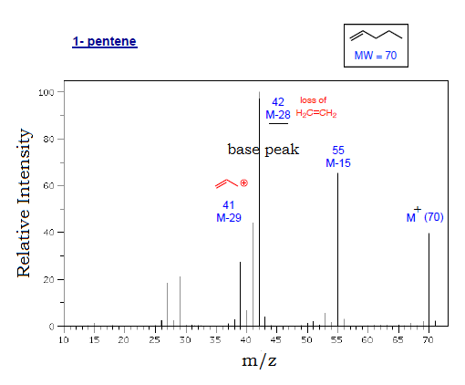

Slide 5
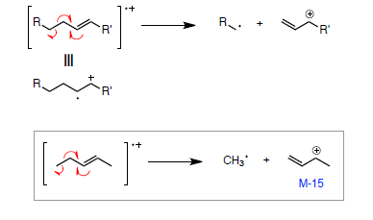
fragmentation processes • McLafferty rearrangement • allylic α-cleavage

Slide 6
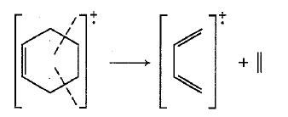
Cyclic Alkenes • Double bonds favor allylic cleavage to give the resonance stabilized allylic carbocation • Cyclohexenes can undergo retro-Diels-Alder reactions; may be significant • Side chains are easily fragmented

Slide 7
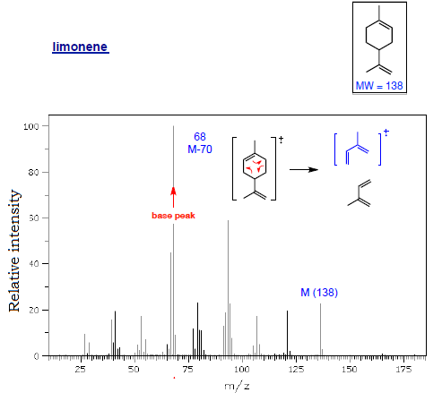

Slide 8
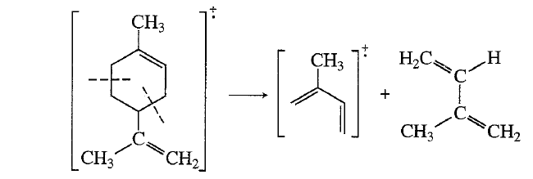

Slide 9
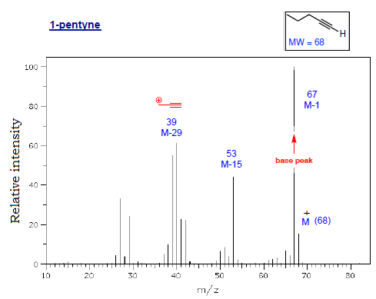
Alkynes • Strong M-1 peak is observed in ter. alkynes • Strong peak from fragmentation to give resonance stabilized propargyl cation(m/z = 39 [important]in terminal alkynes)

